Slide 1

Cursus: Automatic SageMaker Pipeline Compiler
Luke Xie
Buyer Abuse ML
Notes:
Insert your presentation information in the text boxes. Use the “New Slide” dropdown menu to customize your presentation.

Slide 2

Background and Contribution
Design Principles
System Architecture
Pipeline Development Workflow
Building Cursus with Agentic Workflow
Example Pipelines
Notes:
Update the text box to include information about your presentation. To add a custom photo, delete the photo in the slide above, and click to add new photo.

Slide 3
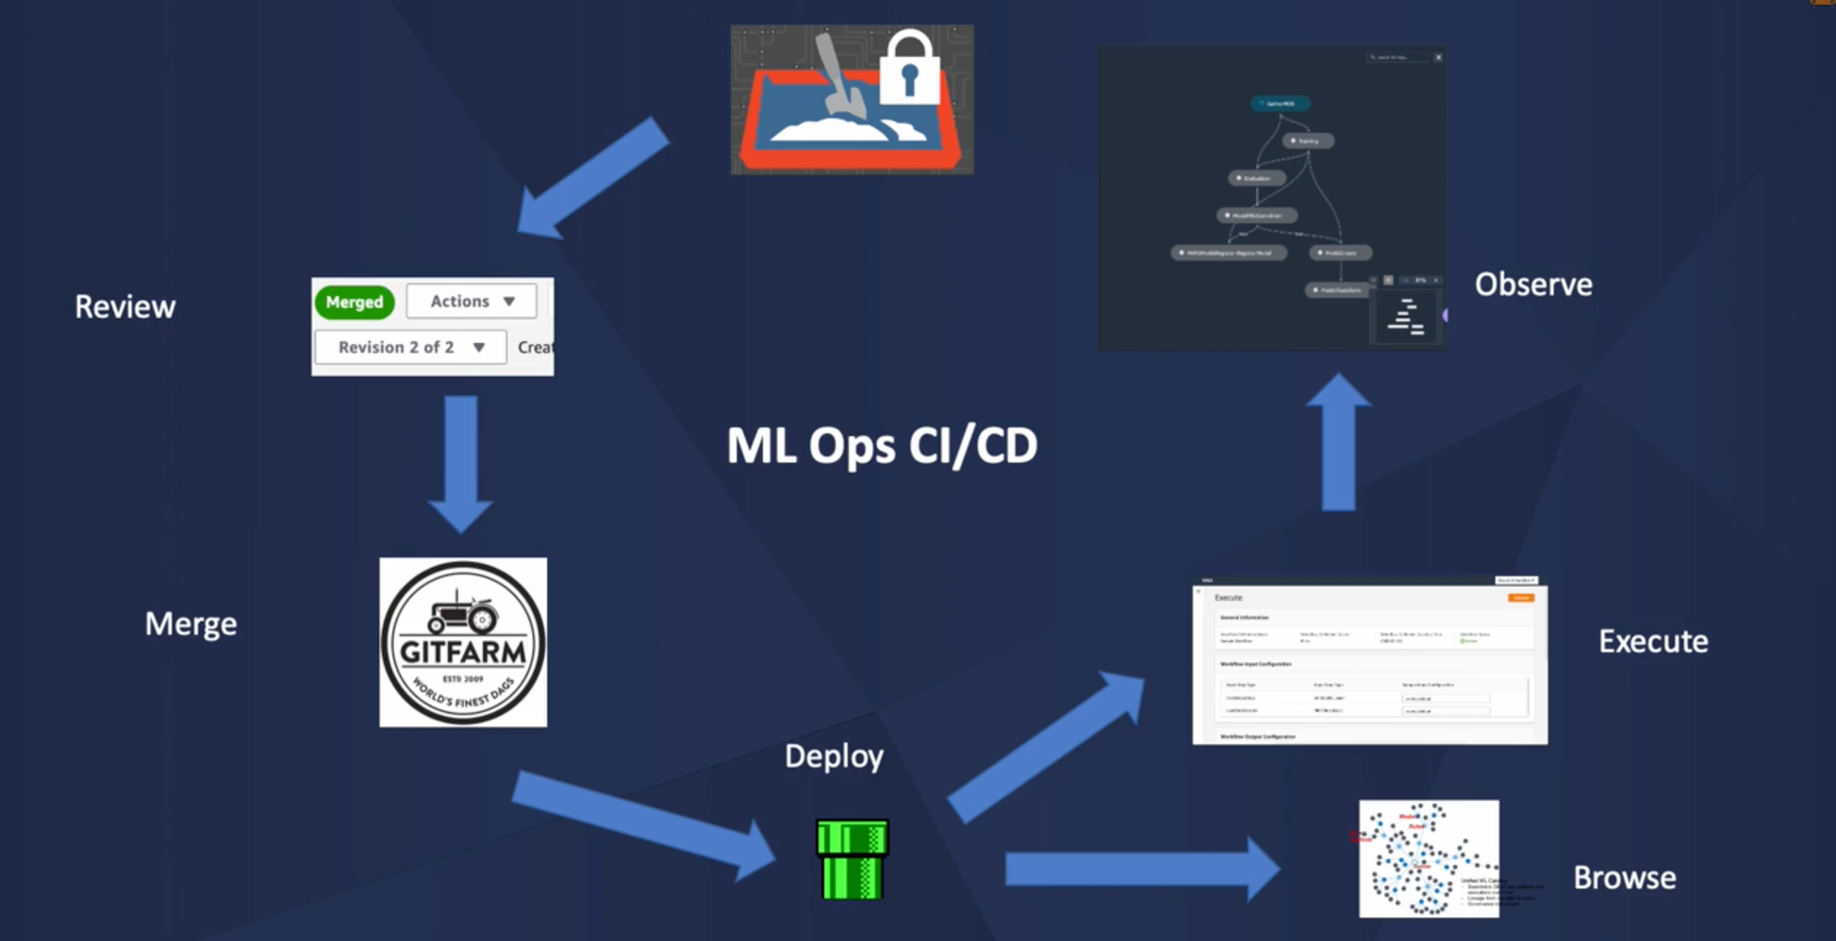
Introduction
Model Training Workflow Operation and Development System (MODS)
MLOps with Amazon Tooling
Continuous Development (CD)
Continuous Integration (CI)
Based on SageMaker Pipeline infrastructure
https://w.amazon.com/bin/view/CMLS/Overview/MODS/
Notes:
Update the text box to include information about your presentation.

Slide 4
Challenge for MODS Adoption
Increase MODS Adoption Rate is a BRP-level Goal
However
Around 50% of the CT models are trained directly in Jupyter notebook, 20% are trained using DAWS, another ~20% are trained using MODS and the remaining ~10% are trained using ML Pigeon.
Development Cycle for MODS is high
For a new model, 4-6 calendar weeks per model to convert it to MODS template, test it, take care of all best practices, code reviews and prod deployment.
For an update of existing model, beside local experiments, it takes another 2-4 calendar weeks per model including the code changes and performance evaluation.
Notes:
Update the text box to include information about your presentation.

Slide 5
Pain Points and Contribution

Slide 6
Pain Points for ML Adoption of MODS Pipeline
Lack of Knowledge on MLOps (Container, SageMaker Pipeline)
Hidden Dependencies in Development and Execution (Code vs. Data)
Redundancy and Repeated Efforts across Domains/Projects
Notes:
Update the text box to include information about your presentation.

Slide 7
Hidden Dependencies for Step Building
DependencySpec
OutputSpec
DependencySpec
OutputSpec
DependencySpec
OutputSpec
Step Input Spec
Step Output Spec
Step Input Spec
Step Output Spec
Step Input Spec
Step Output Spec
Container
Container
Container
Internal Input loc
Internal Output loc
Internal Input loc
Internal Output loc
Internal Input loc
Internal Output loc
Script
Script
Script
Step
Step
Step
Step to Script Dependency: => my input destination / output source
Producer Step Dependency: => my step dependency
Consumer Step Dependency: => my step output
Notes:
Update the text box to include information about your presentation.

Slide 8
Limitation of Legacy Pipeline
There are many existing MODS pipelines. But they all suffer the same issues:
Challenges
Not Scalable:
Most of MODS Template code are end-to-end: example
Easy to be > 800 lines
What if you want to replace one step with another step?
No Separation of Concerns:
Pipeline Architecture vs. Step/Script Implementation
Not Shareable:
Why reinvent the wheel?
What if I want to use one step from your pipeline?
1000 people have 1000 implementation of same equivalent step
Notes:
Update the text box to include information about your presentation.

Slide 9
Contributions
Cursus: Automatic SageMaker/MODS Pipeline Compiler
Graph-to-Pipeline Automation:
NO SageMaker Knowledge for User
97% Development-Time Reduction:
from 4-6 weeks to 4 days
94% Code Reduction:
from 1,000+ lines to 60+ lines
Cursus
Directed Graph (node, edge)
SageMaker Pipeline
Core Cursus is written by AI Agent Cline within 1.5 months, 63,000 lines of code

Slide 10
Design Principles

Slide 11
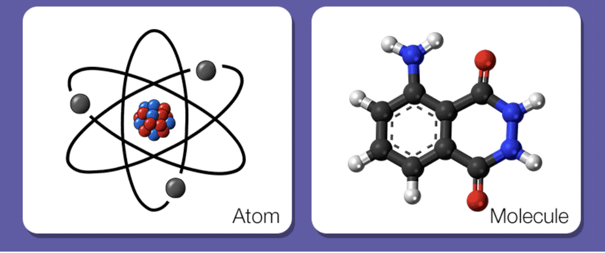
1. Atomic Over Monolithic
“Build from simple, shareable parts, not big, inseparable wholes"
Step is smallest unit of pipeline execution
Pipeline -> Molecule
Step -> Atom
Atomic Step should be
Shareable
Standardized (Script, Step Builder)
Searchable (Register and Step Catalog)
1
3
4
2
1
2
3
4
Notes:
Update the text box to include information about your presentation.

Slide 12
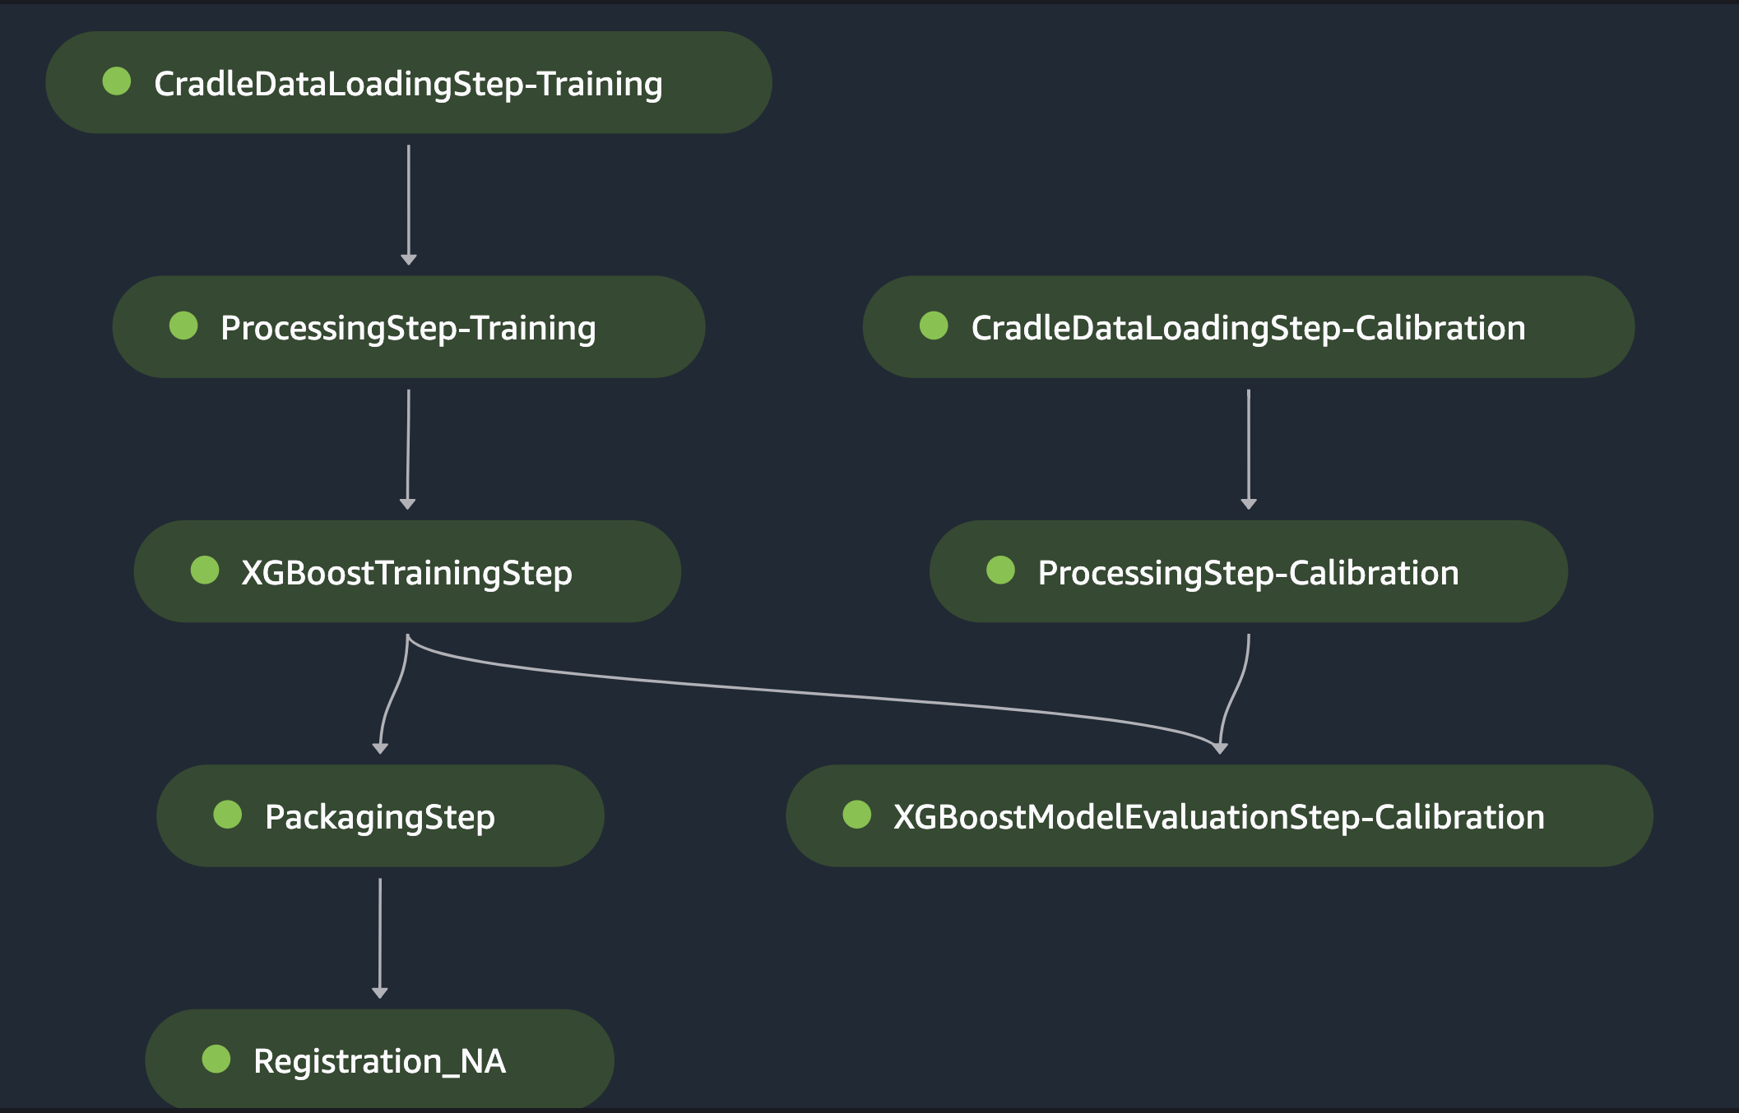
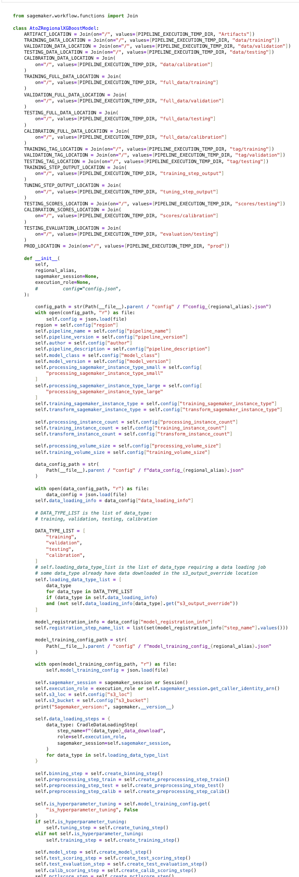
2. Declarative Over Imperative
"Describe what you want, not how to get it"
Declarative Specifications
describe "what”
Example: A DAG that describe the pipeline
Imperative Code
describes "how".
Example:
1000 lines of code
Cursus Package
User
Cursus
1000 lines pipeline code. VS
Notes:
Update the text box to include information about your presentation.

Slide 13
Example: DAG Compiler
Cursus
Directed Graph (node, edge)
SageMaker Pipeline
What
How

Slide 14
Pipeline Generation Workflow using Cursus

Slide 15
Legacy Pipeline Generation
Pipeline DAG (Blueprint)
SageMaker Pipeline
Execute
Execution Doc
User

Slide 16
Pipeline Compilation with Cursus
PipelineDAGCompiler
Pipeline DAG
SageMaker Pipeline
Execute
User
{ StepA: { field 1: val1 } StepB: { field 2: val2 } }
Execution Doc
ExecutionDocumentGenerator
Pipeline Config

Slide 17
Code Comparison
@MODSTemplate(***)
Class MyPipelineLegacy:
def __init__ (**):
self.step_1 = create_cradle_downloading_step()
self.step_2 = create_preprocessing_step()
self.step_3 = create_training_step()
def generate_pipeline():
steps=[self.step_1,
self.step_2 ,
self.step_3
]
return Pipeline(
name=self.pipeline_name,
parameters=[*],
sagemaker_session=*,
steps=steps,
)
def create_cradle_downloading_step()
@MODSTemplate(***)
Class MyPipelineCursus:
def __init__ (**):
self.dag_compiler = PipelineDAGCompiler(
config_path,
parameters,
sagemaker_session
)
self.dag = create_dag() // or load_dag(dag_path)
def generate_pipeline():
pipeline = self.dag_compiler.compile(
dag=self.dag,
**kwargs
)
return pipeline
Fully Automated Pipeline Compile

Slide 18
System Architecture

Slide 19
Overview
1
Compiler API
2
Assembler
Step Library
1
2
3
3
4
1
3
Step Catalog
1
2
Dependency Resolver
Pipeline DAG
4
2
Step Registry
4
…
Alignment
Validation System
n
Runtime

Slide 20
Hierarchical Perspective
Pipeline DAG
User Layer
{Step Name: Step Config}
User Interface
Pipeline DAG Compiler
Pipeline Template Base
Pipeline Assembler
Dependency Resolver
System Layers
Step Specification
Script Contract
Step Builder

Slide 21
Building Cursus with Agentic Workflow

Slide 22
ReACT Paradigm
ReAct Paradigm:
Plan + Act
Plan First, Act Second
Human-in-the-Loop
DO NOT AUTO-APPROVE EDIT
Establish Rules and SOPs (besides tasks) in Prompt
Force LLM to focus on the long-term design, not short-term fix
LLM like dogs chasing ball in front of their eyes
Reflect on past conversation frequently
Download your Chat with LLM.
Plan
Act
Validate
Design
Reflect

Slide 23
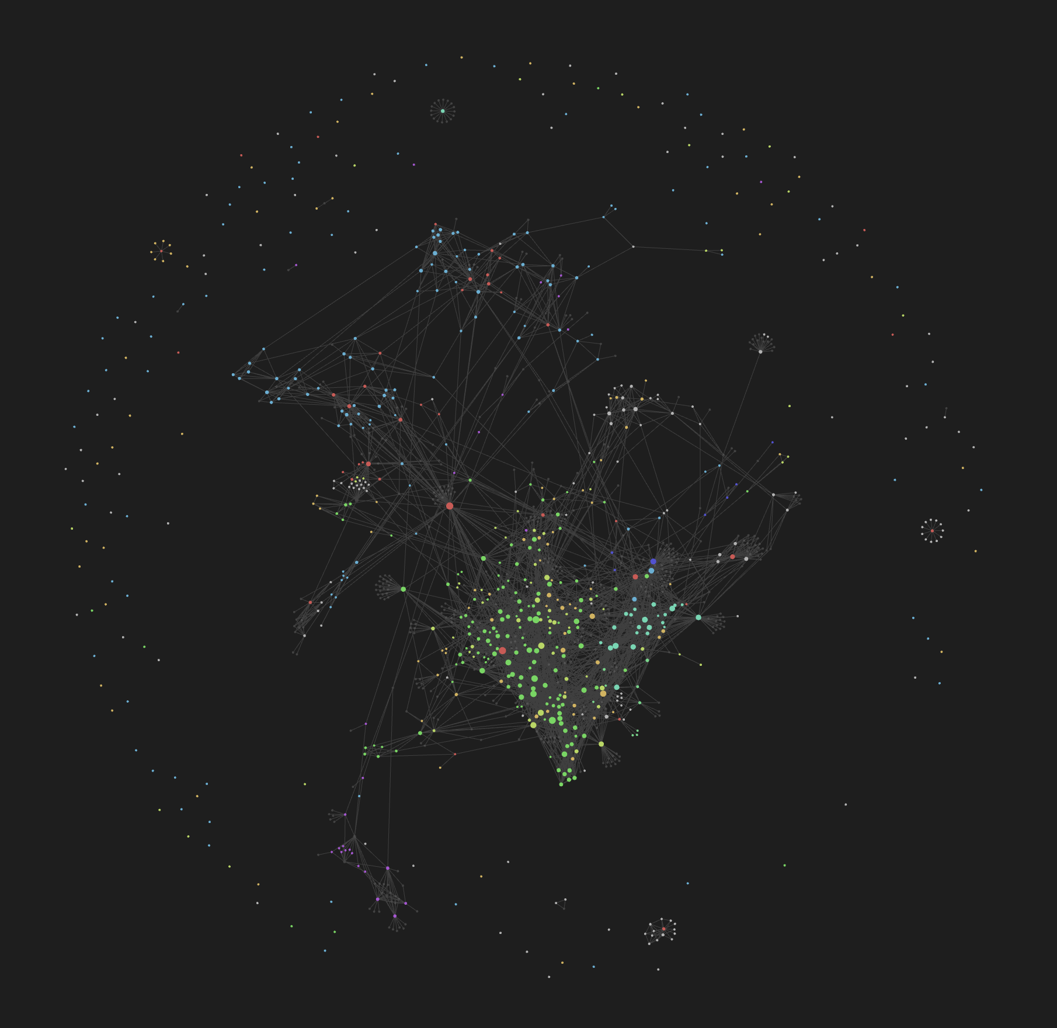
Coding with Slipbox
Slipbox (Zettelkasten)
Knowledge Management System
Key Concept
Atomic Note (Text File) as Knowledge Representation (no embedding!)
Co-reference Note Network
Index Card as Entry Point (no RAG!)
Slipbox for LLM:
Context Engineering
README/Tutorial/Developer Guide
Design Doc
Planning Doc
Code Summary
Slipbox for Cursus

Slide 24
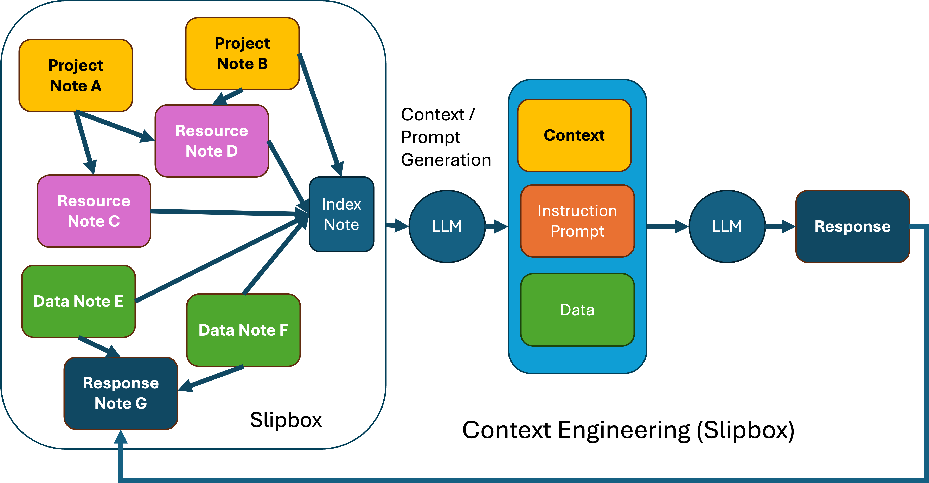
Context Engineering with Slipbox

Slide 25
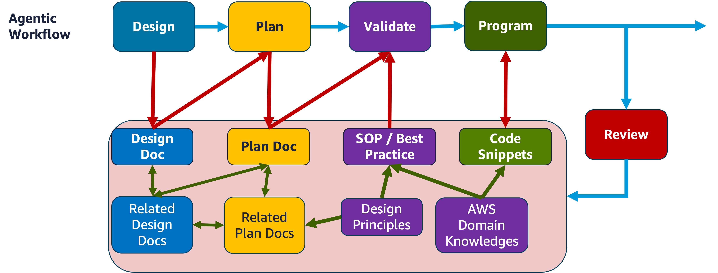
Complete Workflow of Cursus Development
Slipbox

Slide 26
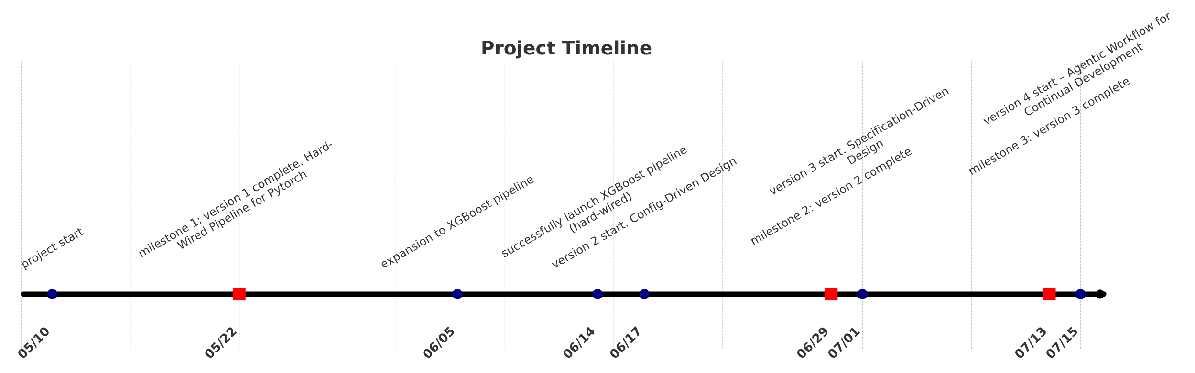
Learning: Better Design Saves Time
Phase 1: Refactoring of Hard-wired Pipeline (Completed 05/22/2025)
Phase 2: Config-Driven Pipeline Automation (Completed 07/01/2025)
Phase 3: Specification-Driven Pipeline Automation (Completed 07/13/2025)
Phase 4: Agentic Workflow for Development (Completed 12/18/2025)
4 Refactoring !

Slide 27
Pipeline Examples

Slide 28
Pipeline Supported in Cursus
BAP Team has used Cursus to launch over 15 different MODS Pipelines
Gradient Boosting Trees:
XGBoost-based Training, LightGBM-based Training
Multi-Task Learning (MTL)
Pytorch-based Training
BSM/CS Chat + Multi-modal BERT
Names2Risk
TSA (Temporal Self-Attention)
Bedrock Batch Inference

Slide 29
XGBoost/LightGBM Pipelines

Slide 30
Example: End-to-End XGBoost Training
There are same nodes in different path (e.g. training path, calibration path), we name our node in this format
“{Step_Name}-{job_type}”
Application Examples:
AtoZ MFN DNR Model
SecureDelivery DNR Model
ContactTime DNR Model and PDA Model
PFW MDR Model
Return-Time MDR Model
MDR-based Active Learning Model
CradleDataLoading-Training
CradleDataLoading-Calibration
TabularPreprocessing-Training
TabularPreprocessing-Calibration
XGBoostTraining
XGBoostModelEval-Calibration
ModelCalibration-Calibration
Payload
Package
Registration
Notes:
Update the text box to include information about your presentation.

Slide 31
Experiments with Dummy Loading
We can replace CradleDataLoading to be DummyDataLoading
DummyDataLoading load from local data
Suitable if
you already have some offline pulled data
Or, you want to test the training phase
DummyDataLoading-Training
DummyDataLoading-Calibration
TabularPreprocessing-Training
TabularPreprocessing-Calibration
XGBoostTraining
XGBoostModelEval-Calibration
ModelCalibration-Calibration
Payload
Package
Registration
Notes:
Update the text box to include information about your presentation.

Slide 32
Experiments with Dummy Training
We can replace XGBoostTraining to be DummyTraining
DummyTraining load from local pretrained model
Suitable if
you already have trained model just want to evaluate performance or registration
DummyDataLoading-Calibration
TabularPreprocessing-Calibration
DummyTraining
XGBoostModelEval-Calibration
ModelCalibration-Calibration
Payload
Package
Registration
Notes:
Update the text box to include information about your presentation.

Slide 33
Variants: Calibration and Testing Paths
We can add Testing Path that focus on OOT inference, metric computation and wiki generation
Calibration Path can focus on model calibration using latest full population
Testing data may be selected with a maturity window
New Steps
XGBoostModelInference
ModelMetricsComputation
ModelWikiGenerator
CradleDataLoading-Training
CradleDataLoading-Calibration
CradleDataLoading-Testing
TabularPreprocessing-Training
TabularPreprocessing-Calibration
TabularPreprocessing-Testing
XGBoostTraining
XGBoostModelEval-Calibration
XGBoostModelInference-Testing
PercentileModelCalibration-Calibration
ModelMetricsComputation-Testing
Payload
Package
ModelWikiGenerator
Registration
Notes:
Update the text box to include information about your presentation.

Slide 34
Variants: Extensive Preprocessing
CradleDataLoading-Training
CradleDataLoading-Calibration
More Detailed Preprocessing Steps are available
StratifiedSampling
MissingValueImputation
RiskTableMapping
FeatureSelection
ActiveSampling
TabularPreprocessing-Training
TabularPreprocessing-Calibration
StratifiedSampling-Training
MissingValueImputation-Training
MissingValueImputation-Calibration
RiskTableMapping-Training
RiskTableMapping-Calibration
XGBoostTraining
Notes:
Update the text box to include information about your presentation.

Slide 35
Registration of Pre-Trained Models
We can swap XGBoostTraining with DummyTraining
DummyTraining load pre-trained models
Example:
Reversal & Reclassification model
ImageClassification model in Seller Grading or Evidence Intelligence
LANTERN model
DummyTraining
Payload
Package
Registration
Notes:
Update the text box to include information about your presentation.

Slide 36
Multi-Task Learning (MTL)

Slide 37
End-to-End LightGBM Training
CradleDataLoading-Training
CradleDataLoading-Calibration
Note:
We can replace XGBoost version to LightGBM version for Training/ModelEval/ModelInference
The same input and output config
Application Examples:
Amazon Business (AB) Abuse Model
TabularPreprocessing-Training
TabularPreprocessing-Calibration
LightGBMTraining
LightGBMModelEval-Calibration
ModelCalibration-Calibration
Payload
Package
Registration
Notes:
Update the text box to include information about your presentation.

Slide 38
Multi-Task Learning with LightGBM-MT
CradleDataLoading-Training
CradleDataLoading-Calibration
Note:
LightGBM-MT is a Multi-Task Learning (MTL) extension of LightGBM
Script for Tabular Preprocessing can be replaced
Script for Model Calibration can be extended to cover MTL
Applications
ContactTime MDR/FLR/NSR model
ContactTime DNR/PDA/RR model
TabularPreprocessing-Training
TabularPreprocessing-Calibration
LightGBMMTTraining
LightGBMMTModelEval-Calibration
ModelCalibration-Calibration
Payload
Package
Registration
Notes:
Update the text box to include information about your presentation.

Slide 39
Pytorch Pipelines

Slide 40
Pytorch Training
Chat Data is available from Cradle
Pytorch Training and Pytorch Model Eval replace the XGBoost version
Support Muti-GPU instances
Example Applications
Multi-modal BERT for BSM AtoZ
Multi-modal BERT for Reversal and Reclassification (RnR)
Abuse Polygraph on CS Chat with DNR
Names2Risk Model
TSA Model
CradleDataLoading-Training
CradleDataLoading-Calibration
TabularPreprocessing-Training
TabularPreprocessing-Calibration
PytorchTraining
PytorchModelEval-Calibration
ModelCalibration-Calibration
Payload
Package
Registration
Notes:
Update the text box to include information about your presentation.

Slide 41
Example: Names2Risk Pytorch Training
CradleDataLoading-Training
CradleDataLoading-Calibration
Add TokenizerTraining Step: train BPE Tokenizer
Update the Tabular Preprocessing
TabularPreprocessing-Training
TabularPreprocessing-Calibration
TokenizerTraining-Training
PytorchTraining
PytorchModelEval-Calibration
ModelCalibration-Calibration
Payload
Package
Registration
Notes:
Update the text box to include information about your presentation.

Slide 42
Example: TSA (Temporal Self-Attention)
Note:
Temporal-Self-Attention requires additional steps, including
TSA Preprocessing
TSA Training
TSA Model Eval
TSA model is based on Pytorch Model
CradleDataLoading-Training
CradleDataLoading-Calibration
TabularPreprocessing-Training
TabularPreprocessing-Calibration
TSA-Preprocessing
TSA-Preprocessing
TSATraining
TSAModelEval-Calibration
ModelCalibration-Calibration
Payload
Package
Registration
Notes:
Update the text box to include information about your presentation.

Slide 43
Other Type of Pipelines

Slide 44
Bedrock LLM Inference
We have also implemented Bedrock Inference Steps
BedrockPromptGeneration
BedrockBatchProcessing
BedrockProcessing
LabelRulesetGeneration
LabelRulesetExecution
DummyDataLoading
TabularPreprocessing-Training
BedrockPromptGeneration
BedrockBatchProcessing-Training
LabelRulesetGeneration
LabelRulesetExecution
Bedrock LLM can be used for Synthetic Label Generation and Model Distillation
PytorchTraining
Notes:
Update the text box to include information about your presentation.

Slide 45
Example: LLM Distillation
CradleDataLoading-Training
CradleDataLoading-Calibration
TabularPreprocessing-Training
TabularPreprocessing-Calibration
BedrockPromptGeneration
BedrockBatchProcessing-Training
BedrockBatchProcessing-Calibration
LabelRulesetGeneration
LabelRulesetExecution-Training
LabelRulesetExecution-Calibration
PytorchTraining
PytorchModelEval-Calibration
ModelCalibration-Calibration
Payload
Package
Registration
Notes:
Update the text box to include information about your presentation.

Slide 46
Variants: SSL Training+ Active Sampling
CradleDataLoading-Training
CradleDataLoading-Testing
CradleDataLoading-Calibration
We can build Semi-Supervised Learning
New Steps
ActiveSampleSelection
PseudoLabelMerge
Provide Support
Sampling based on
Uncertainty
Confidence
Core-Set
Margin / Entropy
TabularPreprocessing-Training
TabularPreprocessing-Testing
TabularPreprocessing-Calibration
XGBoostTraining-Pretrain
XGBoostModelInference-Testing
ActiveSampleSelection
PseudoLabelMerge
XGBoostTraining-FineTune
XGBoostModelEval-Calibration
PercentileModelCalibration-Calibration
Payload
Package
Registration
Notes:
Update the text box to include information about your presentation.

Slide 47
Conclusion

Slide 48
Conclusion
Cursus is an automated MODS/SageMaker Pipeline Compiler
Cursus itself is the product of AI Coding using Slipbox-based Agentic workflow
Cursus is part of MIDAS project initiative which covers broader scope
Slipbox is a new design for context management system that uses
Context Summarization and Reflection
Context Offloading
Context Pruning
Next Plan (New Year Wish):
Help more people esp. in AIT, Payment Risk team to onboard MODS

Slide 49














Acknowledgement
and MODS Team, SAIS Team Leaderships

Slide 50
Thank you!

